Slide 1
NSF Geosciences Program and Budget
Unidata Policy Committee Meeting
Bernard M. Grant,
Assistant Program Coordinator for the Atmospheric and Geospace Sciences Division
14-15 May 2012

Slide 2
Administration Priorities
“Innovation also demands basic research… the same kind of research and innovation that led to the computer chip and the Internet; to new American jobs and new American industries.”
President Barack Obama
2012 State of the Union Address

Slide 3
FY 2013 Request
In 2013, the President is requesting $906,440,000 for GEO; an increase of $21,170,000 or 2.4% above 2012.

Slide 4
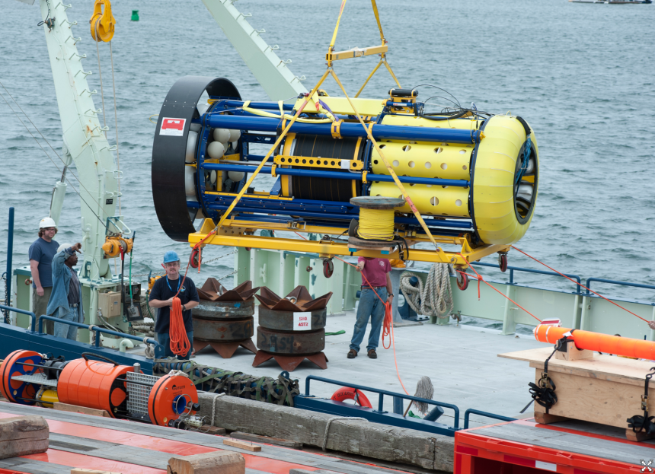
Highlights
Central commitment to basic
research in and across disciplines
Ocean Observatories Initiative (OOI) construction request $65M
Investment in OneNSF areas
Science, Engineering, and Education for Sustainability (SEES)
Cyberinfrastructure Framework for 21st Century Science and Engineering (CIF21)
Expeditions in Education (E²)
Integrated NSF Support Promoting Interdisciplinary Research and Education

Slide 6
Science Engineering and Education for Sustainability (SEES)
Advance science, engineering, and education to inform the societal actions needed for environmental and economic sustainability and sustainable human well-being.
Goals
Build the knowledge base.
Grow workforce of the future.
Forge critical partnerships.
FY13 Investment Highlights
Resilience to natural and technological disasters
Coastal and Arctic systems
Sustainable Chemistry, Engineering and Materials
Improvements in IT energy efficiency

Slide 7
GEO FY13 Investments in SEES
GEO FY13 SEES Request: $70.75M
Hazards and Resilience
Atmospheric and space weather hazards, severe storms, earthquakes, tsunamis, storm surge
Coastal Systems
Interactions among natural and human-driven processes
Pathways to enhance coastal resilience
Ongoing support for Water Sustainability and Climate, Networks, Ocean Acidification, Energy activities

Slide 8
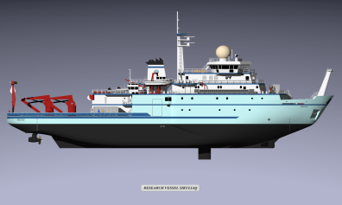
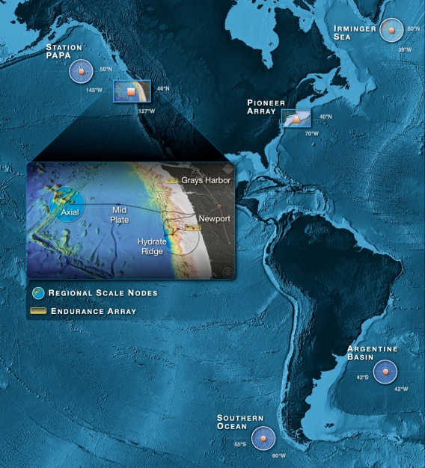
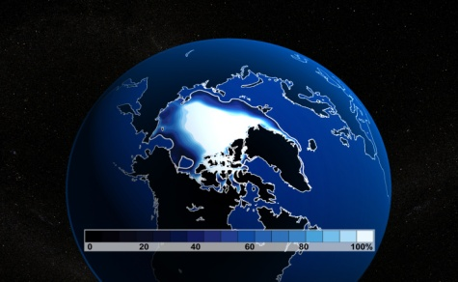
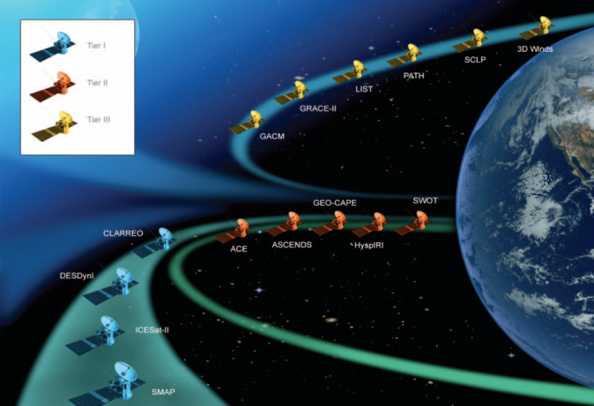
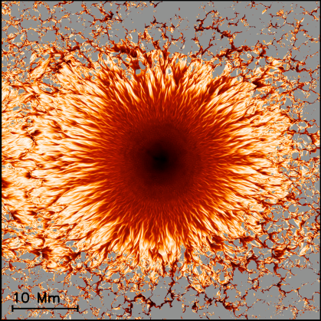
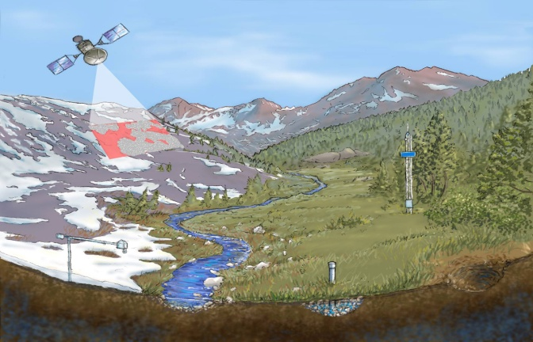
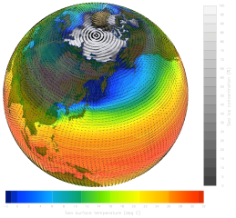
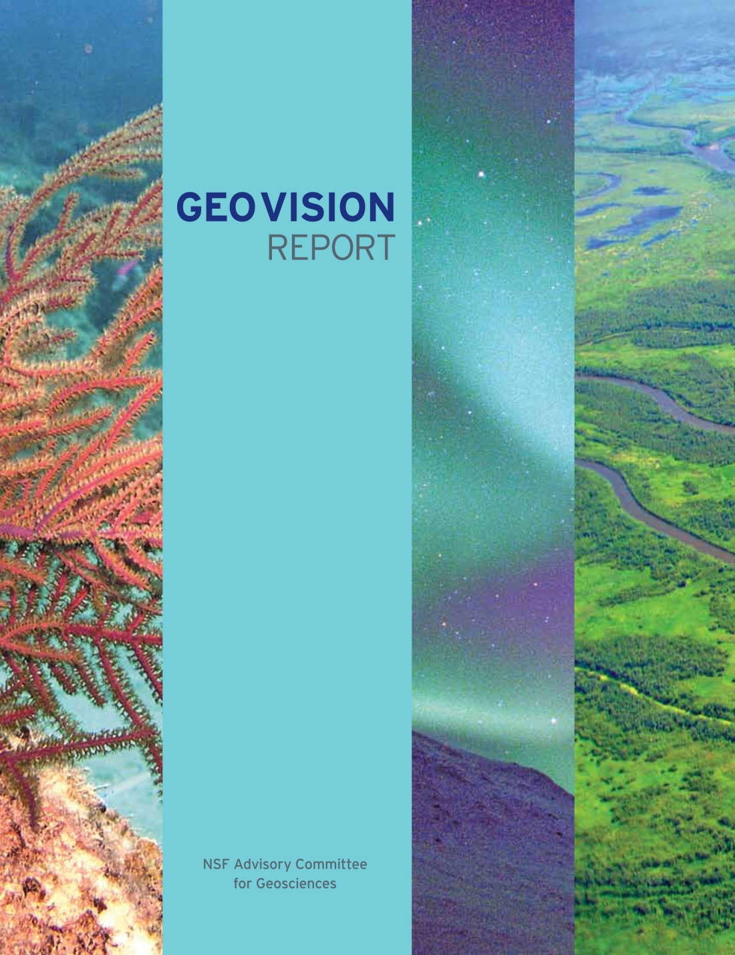
Context & Partnership
GEO is increasing “born-digital”
--- A Major New NSF Activity --- Cyber-Infrastructure For the 21st Century (CIF21)
Builds national infrastructure for S&E
Leverages common methods, approaches, and applications – focus on interoperability
Catalyzes other CI investments across NSF
Provides focus and is a vehicle for coordinating efforts and programs
Based upon a shared governance model involving every directorate and office
Managed as a coherent program by OCI
EarthCube is GEO contribution to CIF21
Arctic Sea Ice
Oceans
EarthScope Observatory
The Science Context
Water
Satellites
Earth System Modeling
The Dynamic Earth
Water: Changing
Perspective
GEO CI
The Changing Climate
Geosphere- Biosphere Connections
Earth and Life

Slide 9
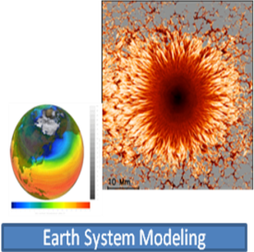
CIF21: EarthCube
GEO FY13 Request: $12.0M
Partnership with Office of Cyberinfrastructure.
Supports research, development, and tools to advance NSF’s goal of data-enabled science.
Integrate geosciences data and high-performance computing technologies in an open, adaptable and sustainable framework (an "Earth Cube") to enable transformative research and education in Earth System Science
Community-guided framework development
Enhancement of connections to facilities

Slide 10
Expeditions in Education (E²)
GEO FY13 Request: $12.0M
Partnership with the Directorate for Education and Human Resources (EHR)
GEO participating in two areas:
Transforming undergraduate STEM leaning
Learning and understanding on sustainability
Involves many existing GEO education and human resource development programs

Slide 11
INSPIRE
GEO FY13 Request: $5.0M
Second year of the CREATIV pilot grant award mechanism
(Creative Research Awards for Transformative Interdisciplinary Ventures)
New interdisciplinary opportunities
Creative high-risk / high-reward interdisciplinary proposals
Provide substantial funding (up to $1M over 5 years)
Open to all NSF-supported areas of science, engineering, and education research
Open pilot mechanism under INSPIRE to begin in FY 2013
Larger “mid-scale” interdisciplinary awards up to $2.5-$3.0M
Utilize novel internal & external merit review approaches

Slide 12
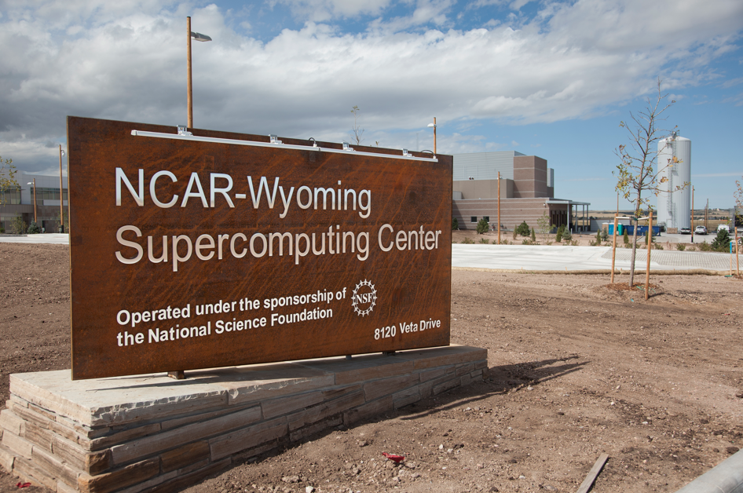
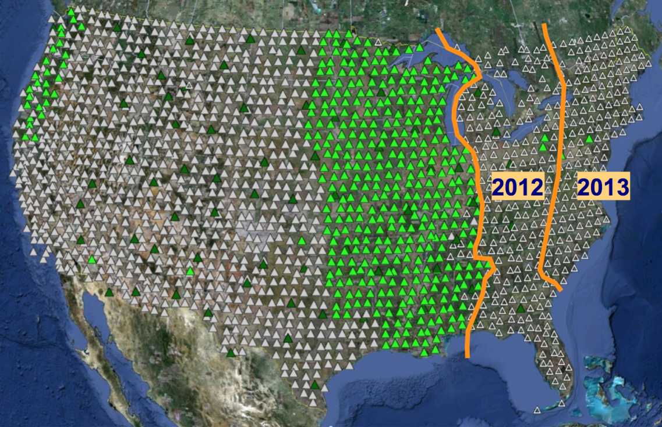
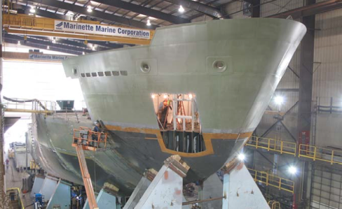
Infrastructure in GEO

Slide 13
Infrastructure Update
Ocean Observatories Initiative
Construction underway
R/V SIKULIAQ
Construction proceeding on schedule
NCAR/Wyoming Supercomputing Center
2012 is the final year of construction
Regional Class Research Vessels
Construction of up to 3 ships is under consideration as an NSF large facility project

